Slide 1

Blinkit Grocery Store Data Analysis
A project by Debasmita Paul

Slide 2
Problem Statement
The Blinkit Grocery Dataset provides an opportunity to uncover insights into sales trends, customer preferences, and store performance. The objective is to analyze the dataset to:
Discover patterns and relationships that drive sales and customer satisfaction.
Optimize product offerings and improve operational efficiency.
Enhance the overall customer experience across outlets and product categories.

Slide 3
Objectives
Examine the sales performance of items grouped by their type, fat content, and visibility.
Evaluate sales data for outlets based on location type (urban/rural), size (small, medium, large), and type (grocery store, supermarket).
Use metrics like total sales, average sales, number of items sold, and customer ratings to evaluate item and outlet performance.
Identify correlations between item characteristics (e.g., weight, fat content) and sales.
Assess whether older outlets perform better or worse compared to newer ones.
Compare sales performance across urban, suburban, and rural outlets.
Examine customer ratings for items and outlets to understand preferences and satisfaction levels.
Break down KPIs (e.g., total sales, number of items sold, average sales) by outlet types (supermarket, grocery store).
Determine whether higher item visibility leads to increased sales.
Look for underperforming outlets or items and propose actionable improvements.

Slide 4
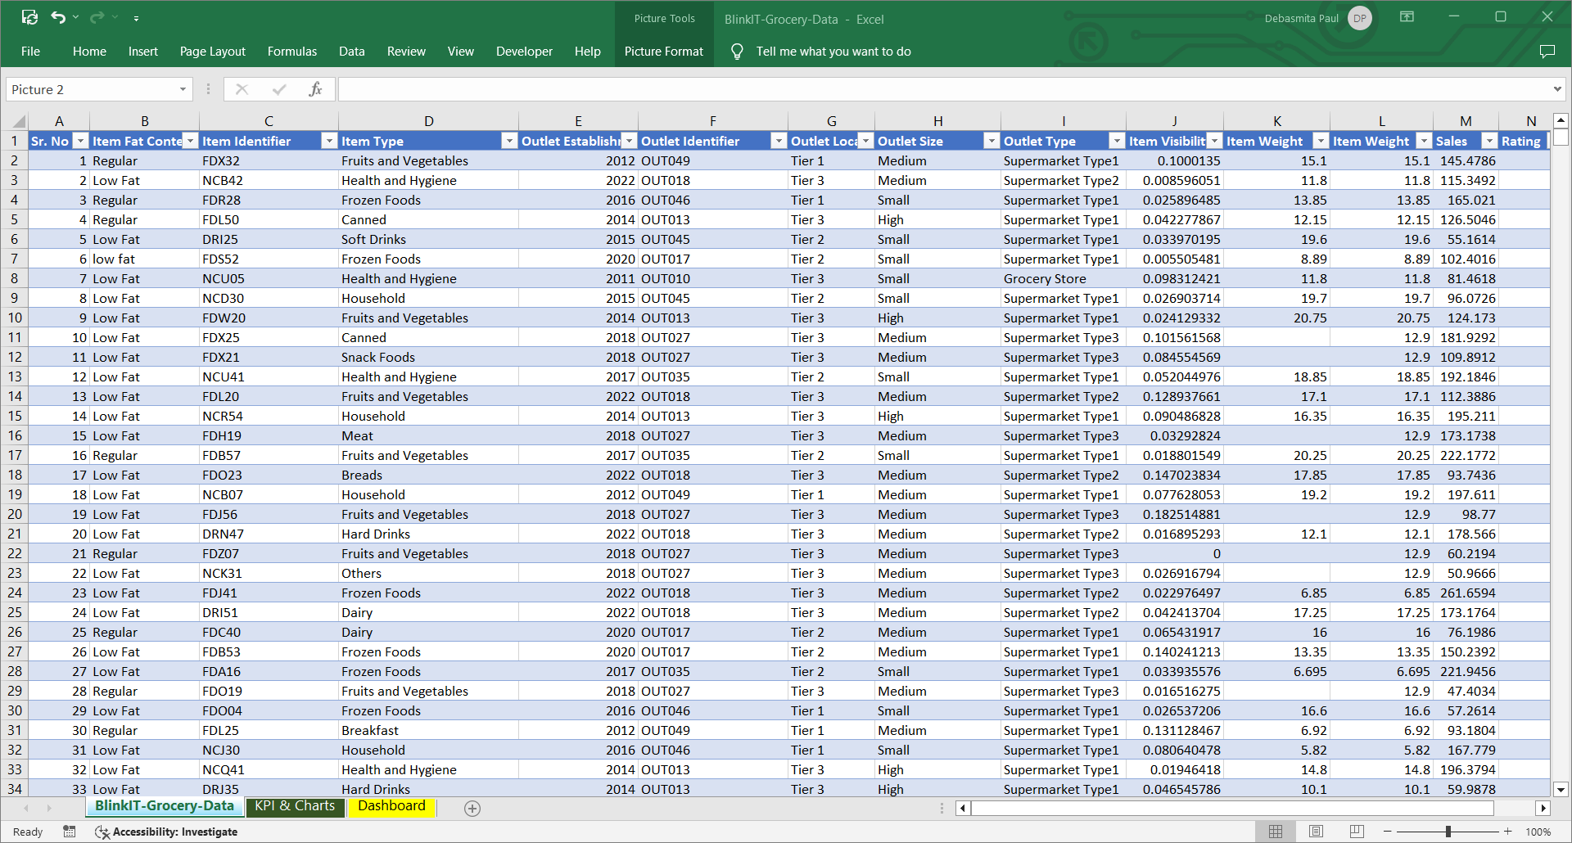
Data Snapshot

Slide 5
Project Roadmap
Raw data
.
Pre-processing
Data Analysis
Insights
Different excel functions and tools were used to solve the key questions from the dataset.
Pivot tables, charts, slicers, sorting and filtering and so on.
Raw dataset was in csv format
Dataset consists of 8524 rows and 12 columns
Data converted in Excel format
Dataset was cleaned to make it usable for performing analysis.
After cleaning final dataset contains 8524 rows and 13 columns.
Outcomes were presented in an excel dashboard.
From the analysis outcomes, several useful insights were generated.

Slide 6
Key Questions
Do items with "Low Fat" content generate more sales compared to "Regular" items, and does this trend vary by outlet type?(Total Sales by Fat Content )
What are the top-performing item types in terms of sales, and how do they vary by outlet type?(Total Sales by Item Type )
How does the total sales performance differ between outlets selling 'Low Fat' and 'Regular' items, and does this vary by outlet type?(Fat Content by Outlet for Total Sales)
Sales Performance Analysis
Outlet Performance and Comparison
Are older outlets (established earlier) performing better or worse in terms of sales compared to newer ones? (Total Sales by Outlet Establishment)
How does outlet size (Small, Medium, High) impact overall sales and item visibility?(Sales by Outlet Size )
Do urban outlets generate higher sales compared to rural outlets? If so, what factors might contribute to this trend?(Sales by Outlet Location )
Is there a relationship between item ratings and their sales across different outlets?(All Metrics by Outlet Type)
Metrics and Ratings

Slide 7
Total Sales by Fat Content
This chart highlights the comparison between total sales of "Low Fat" and "Regular" items. It explores customer preferences, revealing whether healthier options are more popular or if traditional items dominate the sales.
Low Fat" items show a higher share of total sales, indicating a strong preference for healthier products.
"Regular" items, though slightly behind, still contribute a significant portion to overall revenue.

Slide 8
Fat Content for Outlet by Total Sales
This chart explores how the sales of "Low Fat" and "Regular" items vary across different outlet types, such as supermarkets and grocery stores.
Supermarkets tend to perform better in selling "Low Fat" items, possibly due to a diverse customer base and more visibility.
Grocery stores lean toward higher sales of "Regular" items, catering to traditional shoppers.

Slide 9
Total Sales by Item Type
This chart visualizes sales performance across various item categories to identify the best-selling and least popular products.
Certain product types, like beverages and dairy, are consistently high performers.
Categories with lower sales might require targeted marketing or promotional discounts.

Slide 10
Total Sales by Outlet Establishment
Categories with lower sales might require targeted marketing or promotional discounts.
Older outlets tend to have stable sales due to established customer trust and loyalty.
Some newer outlets outperform, particularly in urban locations, driven by modern facilities and better marketing.

Slide 11
Sales by Outlet Size
This chart examines how sales vary by outlet size (Small, Medium, Large).
Large outlets generate the most sales due to their capacity to stock a wider variety of products.
Medium-sized outlets perform moderately, balancing variety and accessibility.
Small outlets, while lower in sales, serve niche markets and rural areas effectively.

Slide 12
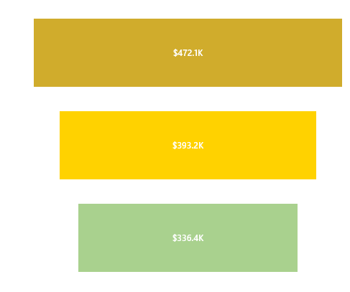
Sales by Outlet Location
This chart evaluates sales performance based on location type—Urban, Suburban, or Rural.
Urban outlets lead in total sales due to a dense customer base and higher spending power.
Suburban outlets show steady performance but have room for growth with localized marketing strategies.
Rural outlets cater to essential needs but show lower sales, highlighting the need for cost-effective strategies.

Slide 13
All Metrics by Outlet Type
This comprehensive chart consolidates metrics like total sales, item visibility, and customer ratings by outlet type.
Supermarkets excel in visibility and ratings due to their size and variety.
Grocery stores show steady performance but may need to enhance visibility and customer engagement to remain competitive.

Slide 14
Business Insights
Low Fat products contribute to 65% of total sales, indicating a preference for health-conscious options among customers.
Fruits, vegetables, and snacks are top-performing categories, while seafood and breakfast items have minimal sales.
Sales peaked in 2018 but show fluctuations in other years.
Large and medium outlets account for 79% of total sales, while small outlets lag behind.
Tier 3 locations outperform Tier 1 and Tier 2, contributing 39% of total sales.
Supermarket Type1 outlets dominate in sales and inventory, while Grocery Stores underperform.
Tier 3 outlets lead in sales for both Low Fat and Regular products, reflecting strong customer engagement.
At $141, this metric suggests room for pricing strategies to increase profitability further.
With an average rating of 4.0, customers appear satisfied, but there is room for improving services or product quality to achieve higher ratings.

Slide 15
Actionable Recommendations
Expand the Low Fat product range to cater to growing demand.
Promote Regular products through discounts or bundling with popular Low Fat items.
Invest in stocking and marketing high-demand categories to maximize revenue.
Identify reasons for lower sales in seafood and breakfast items and explore repositioning them with promotions or targeted campaigns.
Analyze strategies implemented during the 2018 peak and replicate them.
For recently established outlets, focus on brand awareness campaigns to improve sales.
Focus investment in medium and large outlets for higher ROI.
Improve the inventory mix in small outlets and use localized promotions to attract customers.
Leverage Tier 3 success by opening more outlets in similar locations.
Reassess strategies in Tier 1 and Tier 2 locations, focusing on tailored promotions or product assortments for urban customers.
Enhance customer experience in Grocery Stores by diversifying product offerings.
Introduce loyalty programs or discounts in Grocery Stores to boost sales.
Optimize Low Fat product visibility in Tier 2 and Tier 1 outlets to drive similar success.
Create marketing campaigns focusing on Regular products in all Tiers to boost sales balance.

Slide 16
THANK YOU

